Slide 1

Data Aggregation
Strings and Clusterings
Tien-Long Nguyen
Based on joint works with work with
Amir Carmel :PSU - Weizmann Institute of Science
Diptarka Chakraborty :NUS
Kushagra Chaterjee :NUS – Indian Statistical Institute – PSU
Debarati Das :PSU
Romina Nobahari :NUS – Sharif University of Technology

Slide 2
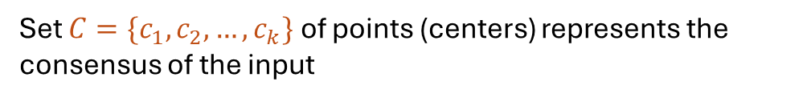
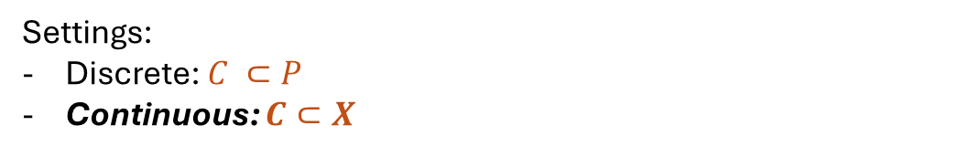
Data aggregation
Input: Point set $P=\left\{p_{1}, p_{2}, …,p_{m}\right\}⊂$ universe $𝒳$
Output:
Set $C=\{c_{1}, c_{2}, …,c_{k}\}$ of points (centers) represents the consensus of the input
Settings:
Discrete: $C ⊂P$
Continuous: $C⊂X$
Applications depend on:
Universe (strings, rankings, clusterings, matrices, points on graphs, …)
Objective function
Metrics

Slide 3
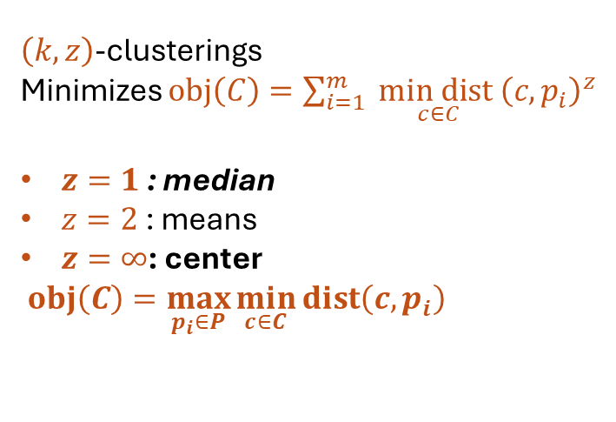
Data aggregation
Input: Point set $P=\left\{p_{1}, p_{2}, …,p_{m}\right\}⊂$ universe $𝒳$
Output:
Set $C=\{c_{1}, c_{2}, …,c_{k}\}$ of points (centers) represents the consensus of the input
$\left(k,z\right)$-clusterings
Minimizes $obj\left(C\right)=\sum_{i=1}^{m}{ \underset{c∈C}{min dist}{\left(c, p_{i}\right)}^{z}}$
$z=1$ : median
$z=2$ : means
$z=∞$: center
$obj\left(C\right)=\max_{p_{i}∈P}{\min_{c∈C}{dist\left(c, p_{i}\right)}}$

Slide 4
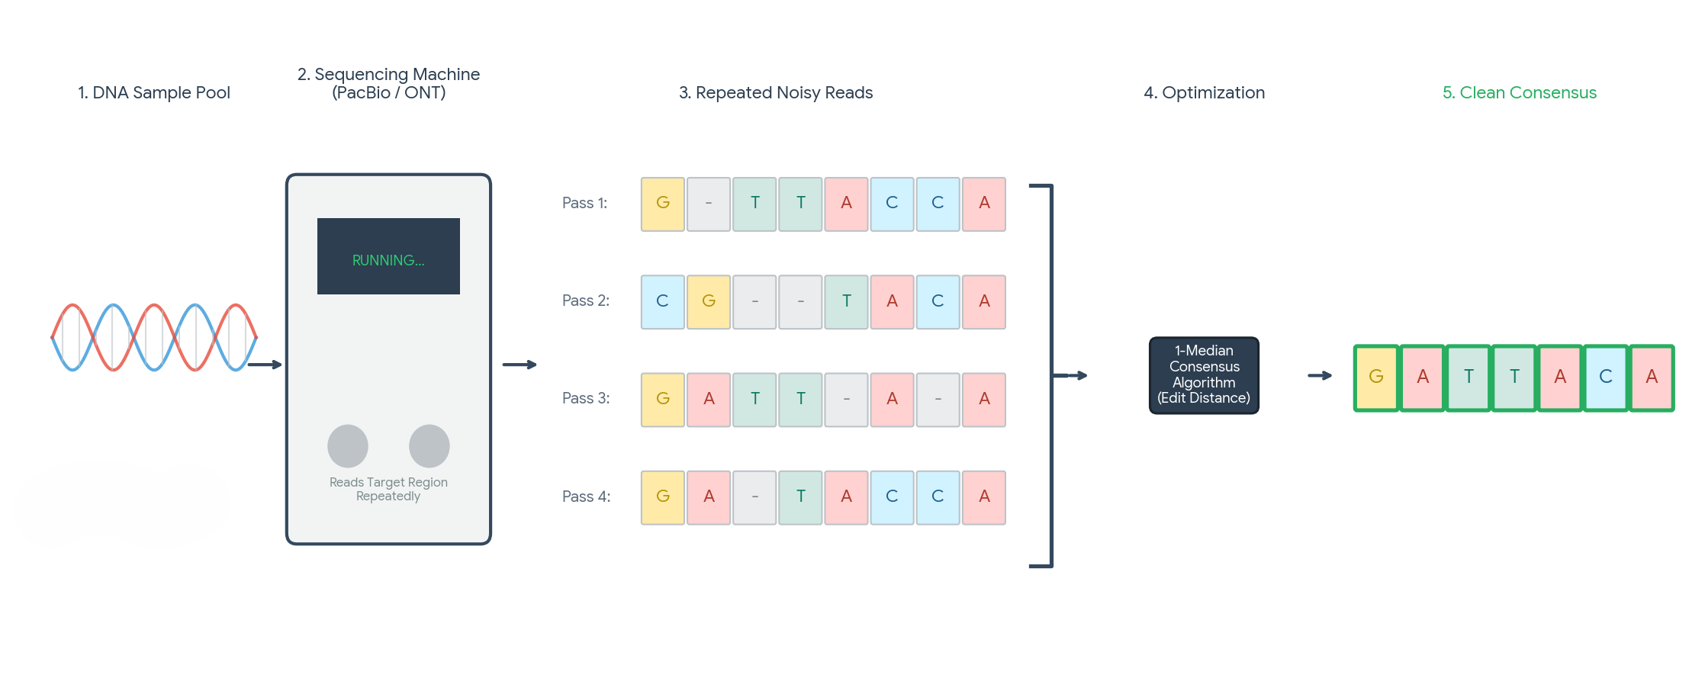
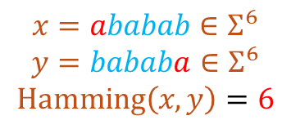
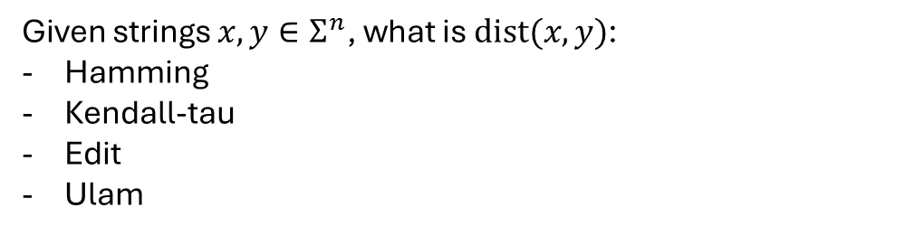
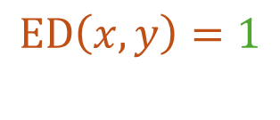
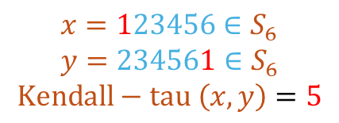
Strings aggregation
$$x=ababab∈Σ^{6}$$
$$y=bababa∈Σ^{6}$$
$$Hamming\left(x,y\right)=6$$
$$x=123456∈S_{6}$$
$$y=234561∈S_{6}$$
$$Kendall−tau \left(x,y\right)=5$$
Given strings $x,y∈Σ^{n}$, what is $dist(x,y)$:
Hamming
Kendall-tau
Edit
Ulam
sensitive to shift, non-aligned error
Preferred (text processing, DNA research …)
$$ED\left(x,y\right)=1$$

Slide 5






Rank aggregation
$$π_{1}$$
1
2
5
4
3
$$π_{2}$$
5
2
1
4
3
Aggregated Rank
$$π_{3}$$
1
3
5
2
4
$$π^{∗}$$
?
?
?
?
?
$$π_{4}$$
2
5
1
4
3
$$π_{5}$$
1
2
3
4
5

Slide 6
Applications of rank aggregation
Elections
Search engines
Web evaluation systems
Recommendation Systems

Slide 7
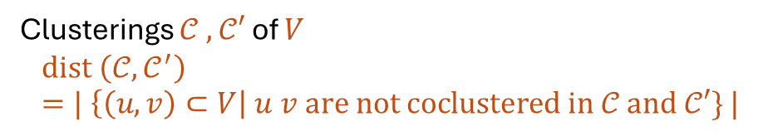
Consensus Clusterings
Ground set V
Output
Input
Clusterings $𝒞 , 𝒞′$ of $V$
$$dist \left(𝒞, 𝒞^{′}\right)=| \left\{\left(u,v\right)⊂V\right| u v are not coclustered in 𝒞 and 𝒞′\} |$$

Slide 8
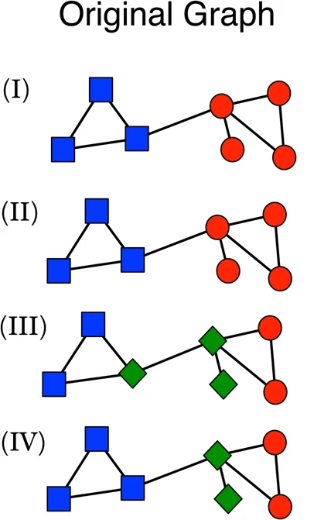

Consensus Clusterings: Applications
Aggregate results from different run of heuristics, randomized algorithms:
Community detection
Gene classification
…
Source: “Consensus clustering in complex networks,” in Sci Rep 2, vol. 335, 2012

Slide 9
Focus
Task 1 (Optimization)
Approximation Factor
Hardness (of approximation)
Task 2 (Scalability)
Distributed (Massively Parallel Computation (MPC), …)
Streaming
Online
Dynamic
Task 3 (Fairness)
Task 1 + Task 2 + Fairness

Slide 10
Highlighted Results
$O\left(1\right)$ rounds MPC $(2−α)$-approx. algorithm for Ulam rank aggregation [CDN, ICALP 26]
$O\left(1\right)$-approx. for Closest Fair Cls. and Fair Cons. Cls. in 2 color settings
[CCDNN, COLT 25]
$O(1)$-approx. for Closest Fair Cls. in multiple color settings[CCDN, AAAI 26]
Streaming & Improved approx. for Fair Cons. Cls. [CCDN, AAMAS 26]

Slide 11
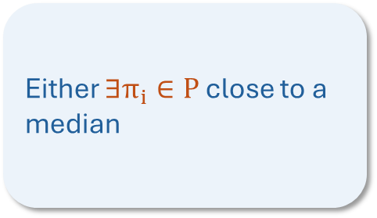

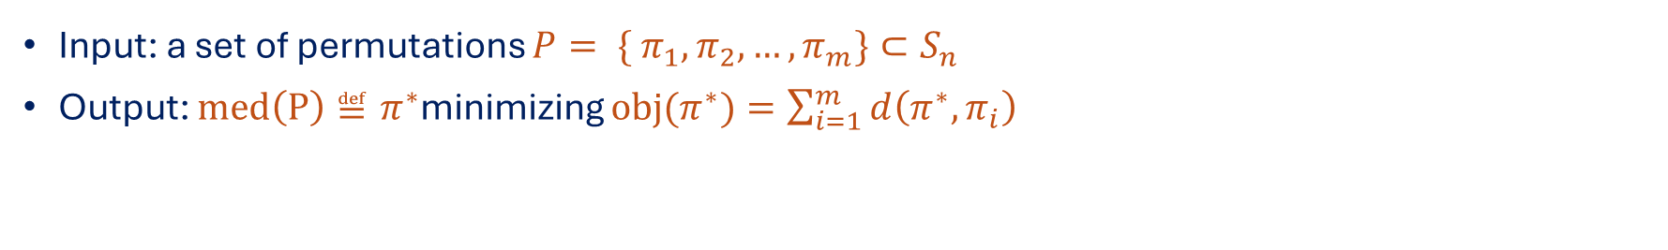
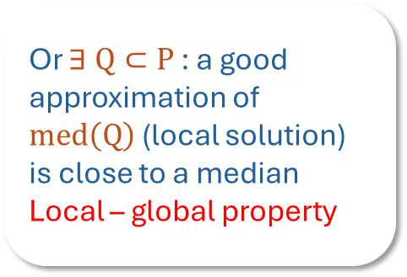
A Scalable and Unified Framework to Weighted Rank Aggregation (ICALP 26)
MPC-friendly Local algorithms (aggregating $Q$)
A new unified framework
Either $∃π_{i}∈P$ close to a median
  Ulam
Kendall-tau
Input: a set of permutations $P= \{ π_{1}, π_{2}, …, π_{m}\}⊂S_{n}$
Output: $med\left(P\right)≝π^{∗}$minimizing $obj(π^{∗})=\sum_{i=1}^{m}{d\left(π^{∗}, π_{i}\right)}$
Or $∃ Q⊂P$ : a good approximation of $med\left(Q\right)$ (local solution) is close to a median
Local – global property
Hamming
Spearman-Footrule

Slide 12
Toward Fair Representation:
Consensus and Clustering (COLT 25)
Ground set V
Output
Input

Slide 13
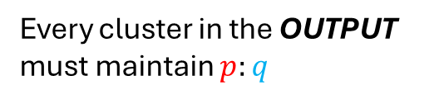

Toward Fair Representation:
Consensus and Clustering (COLT 25)
Ground set V
Output
Input
$$Red\left(V\right):Blue\left(V\right)=p:q$$
Every cluster in the OUTPUT must maintain $p:q$

Slide 14

Toward Fair Representation:
Consensus and Clustering (COLT 25)
Ground set V
Output
Input
$$Red\left(V\right):Blue\left(V\right)=p:q$$
Every cluster in the OUTPUT must maintain $p:q$

Slide 15

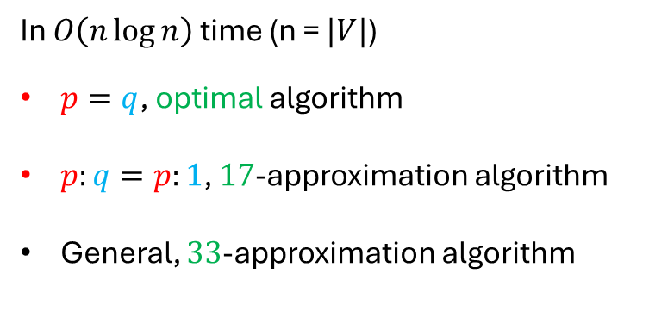
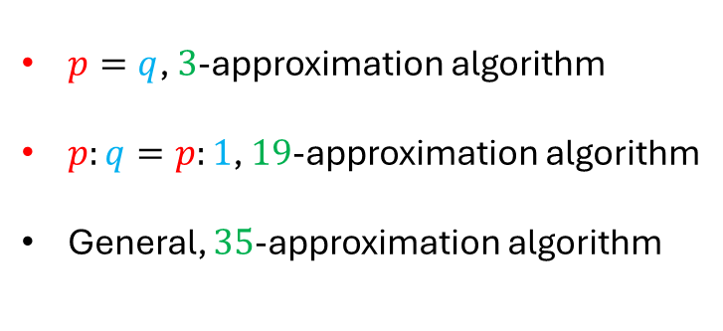

Toward Fair Representation:
Consensus and Clustering (COLT 25)
Fair Consensus Clustering
$\left(2+α\right)$-approximation
$p=q$, $3$-approximation algorithm
$p:q=p:1$, $19$-approximation algorithm
General, $35$-approximation algorithm
Closest Fair Clustering
$α$-approximation
In $O\left(n\log{n}\right)$ time (n = $|V|$)
$p=q$, optimal algorithm
$p:q=p:1$, $17$-approximation algorithm
General, $33$-approximation algorithm
NP-hard

Slide 16

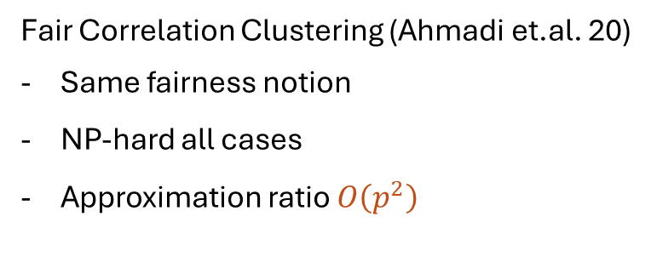
Toward Fair Representation:
Consensus and Clustering (COLT 25)
Fair Consensus Clustering
$p=q$, $3$-approximation algorithm
$p:q=p:1$, $19$-approximation algorithm
General, $35$-approximation algorithm
Fair Correlation Clustering (Ahmadi et.al. 20)
Same fairness notion
NP-hard all cases
Approximation ratio $O\left(p^{2}\right)$
Reduce to
Closest Fair Clustering
In $O\left(n\log{n}\right)$ time (n = $|V|$)
$p=q$, optimal algorithm
$p:q=p:1$, $17$-approximation algorithm
General, $33$-approximation algorithm
Approx ratio: Independent of $p, q$

Slide 17
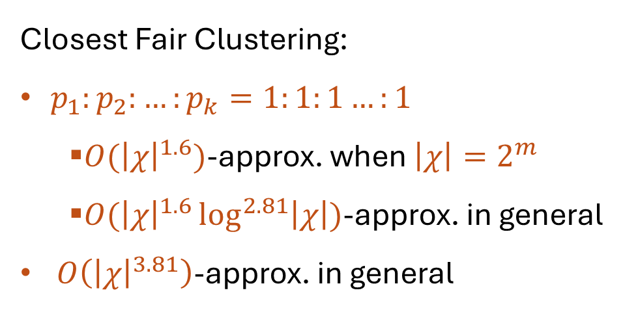
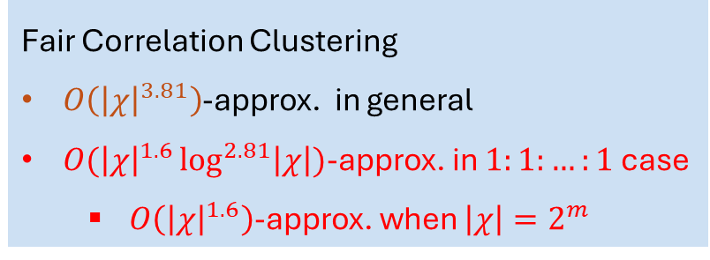
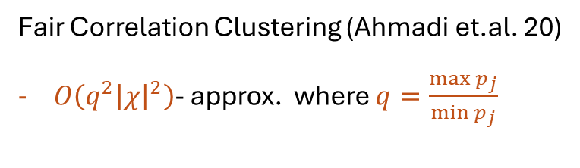
Generalizing to multiple colors (AAAI 26)
Ground set $V$, color set $χ=\left\{c_{1},c_{2},…, c_{k}\right\}$, global ratio $p_{1}:p_{2}:…:p_{k}$
Closest Fair Clustering:
$p_{1}:p_{2}:…:p_{k}=1:1:1…:1$
  $O({\left|χ\right|}^{1.6})$-approx. when $\left|χ\right|=2^{m}$
  $O({\left|χ\right|}^{1.6}\log^{2.81}\left|χ\right|)$-approx. in general
$O\left({\left|χ\right|}^{3.81}\right)$-approx. in general
Already NP-hard for three colors
Fair Correlation Clustering
$O\left({\left|χ\right|}^{3.81}\right)$-approx. in general
$O({\left|χ\right|}^{1.6}\log^{2.81}\left|χ\right|)$-approx. in $1:1:…:1$case
  $O\left({\left|χ\right|}^{1.6}\right)$-approx. when $\left|χ\right|=2^{m}$
Fair Correlation Clustering (Ahmadi et.al. 20)
$O\left(q^{2}{\left|χ\right|}^{2}\right)$- approx. where $q=\frac{\max{p_{j}}}{\min{p_{j}}}$

Slide 18


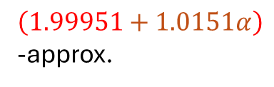





Improved Fair Cons. Cls. & Streaming (AAMAS 26)
Closest Fair Clustering
Fair Consensus Clustering
Streaming
COLT 25
$α$-approx.
$\left(2+α\right)$-approx.
AAMAS 26
AAMAS 26
$1$-median
$\left(1.92+α\right)$-approx.
$\left(1.995+α\right)$-approx.
AAMAS 26
AAMAS 26
$k$-median
$\left(1.92+α\right)$-approx.
$\left(1.99951+1.0151α\right)$ -approx.

Slide 19

Rank aggregation
Aggregated Rank
$$π_{1}$$
1
2
5
4
3
$$π^{∗}$$
?
?
?
?
?
$$π_{2}$$
5
2
1
4
3
What is the objective?
What is the metric?
$$π_{3}$$
1
3
5
2
4
(k-) median
Kendall-tau
$$π_{4}$$
2
5
1
4
3
(k-) center
Edit
$$π_{5}$$
1
2
3
4
5
…
…

Slide 20



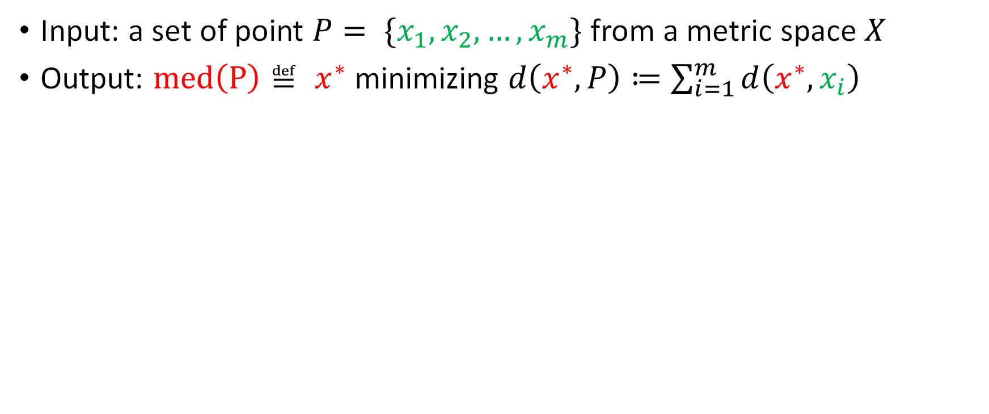



1-Median
Input: a set of point $P= \{x_{1},x_{2},…, x_{m}\}$from a metric space $X$
Output: $med\left(P\right)≝ x^{∗}$ minimizing $d\left(x^{∗}, P\right)≔\sum_{i=1}^{m}{d\left(x^{∗}, x_{i}\right) }$
$$x_{2}$$
$$x_{1}$$
$$x^{∗}$$
$$x_{5}$$
$$x_{3}$$
$$x_{4}$$

Slide 21




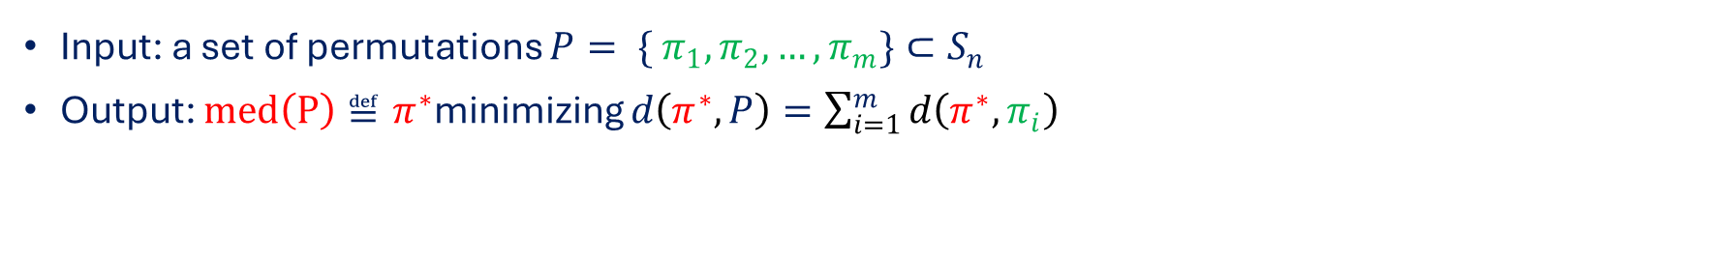



Rank aggregation
Input: a set of permutations $P= \{ π_{1}, π_{2}, …, π_{m}\}⊂S_{n}$
Output: $med\left(P\right)≝π^{∗}$minimizing $d\left(π^{∗}, P\right)=\sum_{i=1}^{m}{d\left(π^{∗}, π_{i}\right)}$
$$π_{2}$$
5
2
1
4
3
$$π_{1}$$
1
2
5
4
3
$$π^{∗}$$
?
?
?
?
?
$$π_{3}$$
1
3
5
2
4
$$π_{4}$$
2
5
1
4
3
Metrics of interest:
Ulam
Kendall-tau
Hamming
Spearman-footrule
$$π_{5}$$
1
2
3
4
5

Slide 22
Scalable and Unified Framework
to Weighted Rank Aggregation

Slide 23


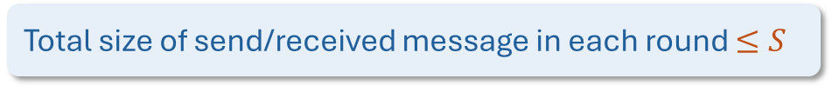

Massively Parallel Computation (MPC) model
All-to-all synchronous-round communication
S
Permutations of size $n$
S
S
Sublinear regime:
Each machine has local memory $S=\tilde{O}\left(n^{1−ε}\right)$
Total size of send/received message in each round $≤S$
S
S

Slide 24


Massively Parallel Computation (MPC) model
$$n^{1−ε}$$
$$n^{1−ε}$$
1
2
5
4
3
1
2
5
4
3

Slide 25



Real world dataset
600 MILION
100 MILION
4 BILLION
Product rankings
User preference lists
Collaborative playlists
300 MILION
5 BILLION
70 MILION
Active user profiles
Ratings permutations
Tracks to aggregate

Slide 26

Massively Parallel Computation (MPC) model
A theoretical abstraction of tools for handling massive data

Slide 27
Results (old and new)
2-approximation algorithm for any metric
Output the best permutation
from the input set
Analysis: triangle inequality
Main questions for some metrics
  Beat the 2-approximation

Slide 28
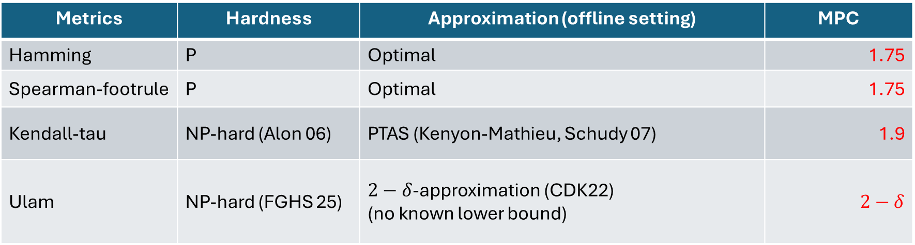
Results (old and new)
New result
Metrics | Hardness | Approximation (offline setting) | MPC
Hamming | P | Optimal | 1.75
Spearman-footrule | P | Optimal | 1.75
Kendall-tau | NP-hard (Alon 06) | PTAS (Kenyon-Mathieu, Schudy 07) | 1.9
Ulam | NP-hard (FGHS 25) | $2−δ$-approximation (CDK22) (no known lower bound) | $$2−δ$$
Via a new unified framework
Remark:
Applies to some weighted version of the above metrics
Improve (weighted) Ulam to 1.968 in offline setting
Notes:
Change 1.9999 to 2-\delta

Slide 29



Our contributions
MPC-friendly Local algorithms (aggregating $Q$)
A new unified framework
Either $∃π_{i}∈P$ close to a median
  Ulam
Kendall-tau
Or $∃ Q⊂P$ : a good approximation of $med\left(Q\right)$ (local solution) is close to a median
Local – global property
Hamming
Spearman-Footrule

Slide 30
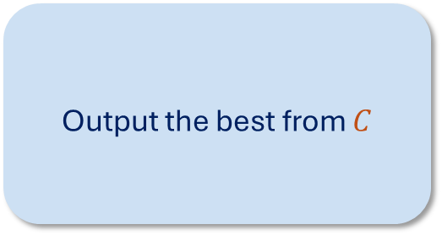
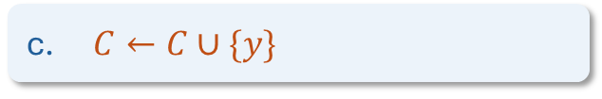
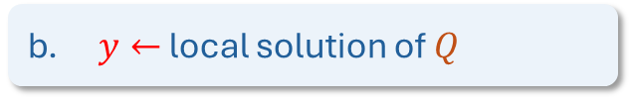
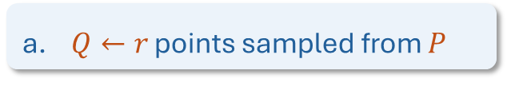
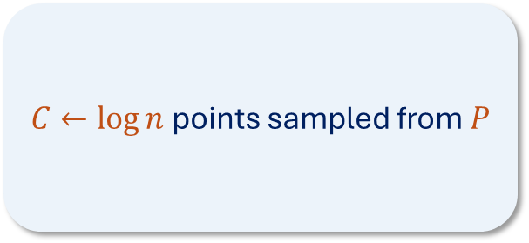
Framework overview
Repeat $\log{n}$ times:
$C←\log{n}$points sampled from $P$
Output the best from $C$
a. $Q←r$ points sampled from $P$
b. $y←$ local solution of $Q$
c. $C←C∪\{y\}$
Notes:
Pop out local algorithm step

Slide 31











Quantify Triangle Inequality
$P=\left\{p_{1},p_{2}, …, p_{n}\right\}⊂$ a metric space $(𝒳, dist )$.
Slack
$$∀x∈𝒳: Δ_{i,j}\left(x\right)= dist\left(x, p_{i}\right)+ dist\left(x,p_{j}\right)− dist(p_{i}, p_{j})$$
$$p_{i}$$
$$dist\left(p_{i},p_{j}\right)$$
$$p_{j}$$
Quantify triangle inequality
$$dist\left(x,p_{i}\right)$$
$$p_{i}$$
$$dist\left(x,p_{j}\right)$$
$$x$$
Small $Δ_{i,j}\left(x\right)⇒p_{i}, p_{j}$ are far
$$p_{j}$$
$$x$$
Notes:
Pop out local algorithm step

Slide 32
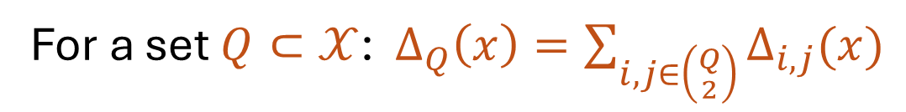
Quantify Triangle Inequality
$P=\left\{p_{1},p_{2}, …, p_{n}\right\}⊂$ a metric space $(𝒳, dist )$.
$$∀x∈𝒳: Δ_{i,j}\left(x\right)= dist\left(x, p_{i}\right)+ dist\left(x,p_{j}\right)− dist(p_{i}, p_{j})$$
For a set $Q⊂𝒳$: $Δ_{Q}\left(x\right)=\sum_{i,j∈\left({Q \atop 2}\right)}{Δ_{i,j}(x)}$
Fix an optimal solution $x^{∗}$: ${Δ^{∗}≜Δ}_{Q}\left(x\right)=\sum_{i,j∈\left({Q \atop 2}\right)}{Δ_{i,j}(x)}$
Notes:
Pop out local algorithm step

Slide 33
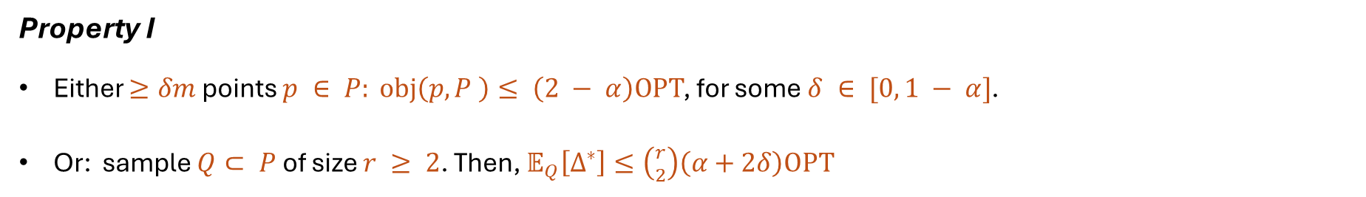
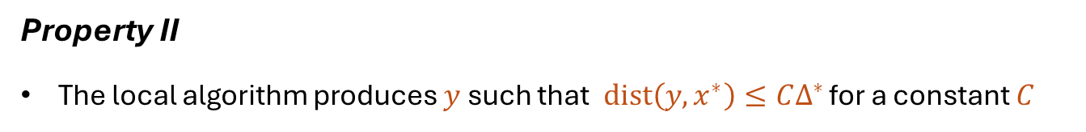
Key Properties
Property I
Either $≥δm$ points $p ∈ P: obj\left(p, P \right)≤ \left(2 − α\right)OPT$, for some $δ ∈ [0, 1 − α]$.
Or: sample $Q⊂ P$ of size $r ≥ 2$. Then, $𝔼_{Q}\left[Δ^{∗}\right]≤\left({r \atop 2}\right)\left(α+2δ\right)OPT$
Property II
The local algorithm produces $y$ such that $dist\left(y, x^{∗}\right)≤CΔ^{∗}$ for a constant $C$
Notes:
Pop out local algorithm step

Slide 34

Key Properties
Property I
Either $≥δm$ points $p ∈ P: obj\left(p, P \right)≤ \left(2 − α\right)OPT$, for some $δ ∈ [0, 1 − α]$.
Or: sample $Q⊂ P$ of size $r ≥ 2$. Then, $𝔼_{Q}\left[Δ^{∗}\right]≤\left({r \atop 2}\right)\left(α+2δ\right)OPT$
$$x^{∗}$$
Property II
The local algorithm produces $y$ such that $dist\left(y, x^{∗}\right)≤CΔ^{∗}$ for a constant $C$
Notes:
Pop out local algorithm step

Slide 35

Key Properties
Property I
Either $≥δm$ points $p ∈ P: obj\left(p, P \right)≤ \left(2 − α\right)OPT$, for some $δ ∈ [0, 1 − α]$.
Or: sample $Q⊂ P$ of size $r ≥ 2$. Then, $𝔼_{Q}\left[Δ^{∗}\right]≤\left({r \atop 2}\right)\left(α+2δ\right)OPT$
$$y$$
$$x^{∗}$$
Property II
The local algorithm produces $y$ such that $dist\left(y, x^{∗}\right)≤CΔ^{∗}$ for a constant $C$
Notes:
Pop out local algorithm step

Slide 36
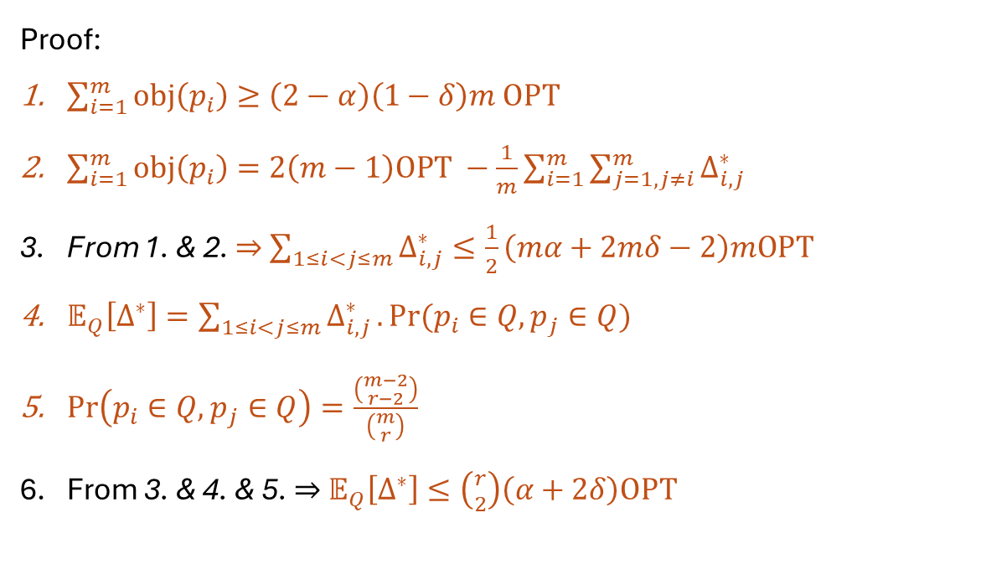
Key Properties
Property I
Either $≥δm$ points $p ∈ P: obj\left(p, P \right)≤ \left(2 − α\right)OPT$, for some $δ ∈ [0, 1 − α]$.
Or: sample $Q⊂ P$ of size $r ≥ 2$. Then, $𝔼_{Q}\left[Δ^{∗}\right]≤\left({r \atop 2}\right)\left(α+2δ\right)OPT$
Proof:
$\sum_{i=1}^{m}{obj\left(p_{i}\right)}≥\left(2−α\right)\left(1−δ\right)m OPT$
$\sum_{i=1}^{m}{obj\left(p_{i}\right)}=2\left(m−1\right)OPT −\frac{1}{m}\sum_{i=1}^{m}{\sum_{j=1, j≠i}^{m}{Δ_{i,j}^{∗}}}$
From 1. & 2. $⇒$ $\sum_{1≤i<j≤m}{Δ_{i,j}^{∗}}≤\frac{1}{2}\left(mα+2mδ−2\right)mOPT$
$𝔼_{Q}\left[Δ^{∗}\right]=\sum_{1≤i<j≤m}{Δ_{i,j}^{∗}}. Pr(p_{i}∈Q, p_{j}∈Q)$
$Pr\left(p_{i}∈Q, p_{j}∈Q\right)=\frac{\left({m−2 \atop r−2}\right)}{\left({m \atop r}\right)}$
From 3. & 4. & 5. $⇒$ $𝔼_{Q}\left[Δ^{∗}\right]≤\left({r \atop 2}\right)\left(α+2δ\right)OPT$
Notes:
Pop out local algorithm step

Slide 37
Key Properties
Property I
Either $≥δm$ points $p ∈ P: obj\left(p, P \right)≤ \left(2 − α\right)OPT$, for some $δ ∈ [0, 1 − α]$.
Or: sample $Q⊂ P$ of size $r ≥ 2$. Then, $𝔼_{Q}\left[Δ^{∗}\right]≤\left({r \atop 2}\right)\left(α+2δ\right)OPT$
$$y$$
$$x^{∗}$$
Property II
The local algorithm produces $y$ such that $dist\left(y, x^{∗}\right)≤CΔ^{∗}$ for a constant $C$
Notes:
Pop out local algorithm step

Slide 38

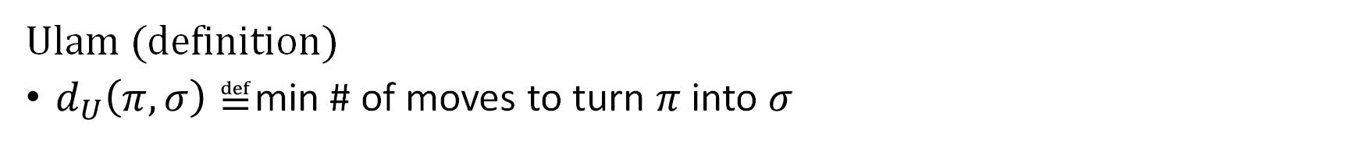



Ulam distance
Ulam (definition)
$d_{U}\left(π, σ\right)≝$min # of moves to turn $π$ into $σ$
$$π$$
1
2
5
4
3
1
2
5
4
3
$$d_{U}\left(12543, 52143\right)=2$$
$$σ$$
5
2
1
4
3
2
1
5
4
3
1 move = 1 delete + 1 insert $⇒$ Edit distance with no substitutions
$d_{U}\left(π, σ\right)≝$min $\frac{1}{2}$ # (ins + del) operations to turn $π$ into $σ$

Slide 39





Aggregating under Ulam
Input: $Q=\{π_{1},π_{2},π_{3},π_{4},π_{5}\}$
$$π_{1}$$
1
2
5
4
3
$$π_{2}$$
5
2
1
4
3
$$π_{3}$$
2
5
1
4
3
$$π$$
?
?
?
?
?
$$≈med\left(Q\right)$$
$$π_{4}$$
1
3
5
2
4
$$π_{5}$$
1
2
3
4
5

Slide 40

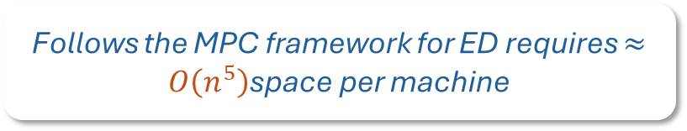
Dynamic Programming Approach
Compute $x={argmin}_{y∈\{1,2,…, n\}^{n}}\sum_{i=1}^{5}{d\left(y,π_{i}\right)}$via dp
Remove repeated symbols
Append the missing symbols arbitrarily at the end
Work in offline setting
Follows the MPC framework for ED requires $≈O\left(n^{5}\right)$space per machine

Slide 41








Cycle Removal Approach (CDK 21)
Build a majority graph
$$π_{1}$$
1 | 2 | 5 | 4 | 3
$$1$$
$$2$$
$$π_{2}$$
5 | 2 | 1 | 4 | 3
$$π_{3}$$
2 | 5 | 1 | 4 | 3
$$π_{4}$$
1 | 3 | 5 | 2 | 4
$$3$$
$$5$$
$$π_{5}$$
1 | 2 | 3 | 4 | 5
$$4$$

Slide 42





Cycle Removal Approach (CDK 21)
Build a majority graph
$$1$$
$$2$$
While $∃$a cycle $C$(a triangle)
Remove C
$$3$$
$$5$$
$$4$$

Slide 43




Cycle Removal Approach (CDK 21)
Build a majority graph
$$1$$
$$2$$
While $∃$a cycle $C$(a triangle)
  Remove $C$
12
Topological sort
Append removed symbols in arbitrary order
12345

Slide 44
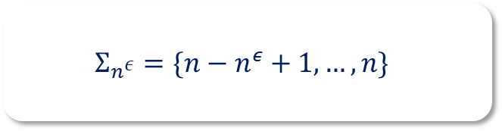

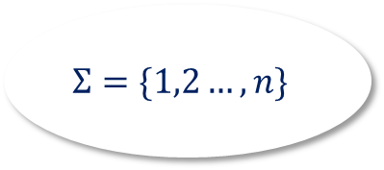
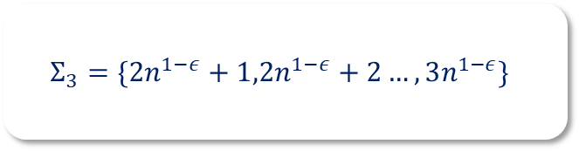

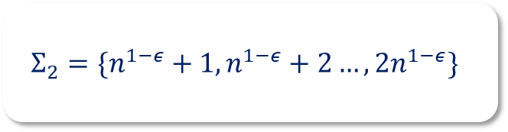



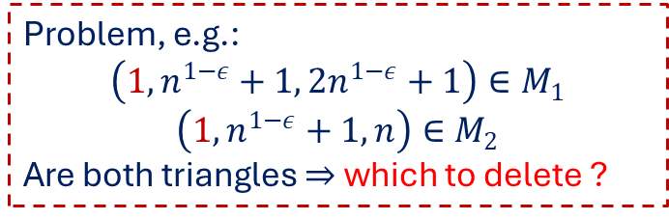


Attempt for MPC Cycle Removal
$$Σ_{1}=\{1,2…, n^{1−ε}\}$$
$$M_{1}$$
$$M_{2}$$
$$Σ_{1},Σ_{2},Σ_{3}$$
$$Σ_{1},Σ_{2},Σ_{n^{ε}}$$
$$Σ_{2}=\{n^{1−ε}+1,n^{1−ε}+2…, 2n^{1−ε}\}$$
…
$$Σ=\{1,2…, n\}$$
$$M_{n^{3ε}}$$
$$Σ_{3}=\{{2n}^{1−ε}+1,2n^{1−ε}+2…, 3n^{1−ε}\}$$
$$Σ_{n^{ε}−2},Σ_{n^{ε}−1},Σ_{n^{ε}}$$
…
Problem, e.g.:
$$\left(1, n^{1−ε}+1, 2n^{1−ε}+1\right)∈M_{1}$$
$$\left(1, n^{1−ε}+1, n\right)∈M_{2}$$
Are both triangles $⇒$ which to delete ?
$$Σ_{n^{ε}}=\{n−n^{ε}+1,…, n\}$$

Slide 45



Succes attempt = DP + Cycle Removal
Ideas:
If $π_{i,j}$ is of medium size (not long/short) $⇒$ possible to “guess” approximately
$$π_{i}$$
$$π_{i,1}$$ | $$π_{i,2}$$ |  | $$π_{i,n^{ε}}$$
Optimal alignment
$$med\left(Q\right)$$
$$B_{1}$$ | $$B_{2}$$ | … | $$B_{n^{ε}}$$
$$n^{1−ε}$$
Notes:
Chek laij phaanf ideas xem co bii nham trang k

Slide 46



Succes attempt = DP + Cycle Removal
Ideas:
If $π_{i,j}$ is of medium size (not long/short) $⇒$ possible to “guess” approximately
$$π_{i}$$
$$π_{i,1}$$ | $$π_{i,2}$$ |  | $$π_{i,n^{ε}}$$
$$med\left(Q\right)$$
$$B_{1}$$ | $$B_{2}$$ | … | $$B_{n^{ε}}$$
$$n^{1−ε}$$

Slide 47
Succes attempt = DP + Cycle Removal
Ideas:
If $π_{i,j}$ is of medium size (not long/short) $⇒$ possible to “guess” approximately
$$π_{i}$$
$$π_{i,1}$$ | $$π_{i,2}$$ |  | $$π_{i,n^{ε}}$$
$$med\left(Q\right)$$
$$B_{1}$$ | $$B_{2}$$ | … | $$B_{n^{ε}}$$
$$n^{1−ε}$$

Slide 48
Succes attempt = DP + Cycle Removal
Ideas:
If $π_{i,j}$ is of medium size (not long/short) $⇒$ possible to “guess” approximately
$$π_{i}$$
$$π_{i,1}$$ | $$π_{i,2}$$ |  | $$π_{i,n^{ε}}$$
$$med\left(Q\right)$$
$$B_{1}$$ | $$B_{2}$$ | … | $$B_{n^{ε}}$$
$$n^{1−ε}$$

Slide 49
Succes attempt = DP + Cycle Removal
Ideas:
If $π_{i,j}$ is of medium size (not long/short) $⇒$ possible to “guess” approximately
$$π_{i}$$
$$π_{i,1}$$ | $$π_{i,2}$$ |  | $$π_{i,n^{ε}}$$
$$med\left(Q\right)$$
$$B_{1}$$ | $$B_{2}$$ | … | $$B_{n^{ε}}$$
$$n^{1−ε}$$

Slide 50

Succes attempt = DP + Cycle Removal
Ideas:
If $π_{i,j}$ is of medium size (not long/short) $⇒$ possible to “guess” approximately
$$π_{i}$$
$$π_{i,1}$$ | $$π_{i,2}$$ |  | $$π_{i,n^{ε}}$$
$${π′}_{i,j}$$
$$med\left(Q\right)$$
$$B_{1}$$ | $$B_{2}$$ | … | $$B_{n^{ε}}$$
$$n^{1−ε}$$

Slide 51










Succes attempt = DP + Cycle Removal
Ideas:
If $π_{i,j}$ is of medium size (not long/short) $⇒$ possible to “guess” approximately
Fix an index block $j$, if at least 4 of $π_{1,j}, π_{2,j},…, π_{5,j}$are of medium size $⇒$ “reconstruct” $B_{j}$ via “cycle removal”
$$B_{j}$$
shares a long LCS
$${B′}_{j}$$
$$π_{1,j}$$
$${π′}_{1,j}$$
$$π_{2,j}$$
guess
$${π′}_{2,j}$$
$$π_{4,j}$$
$${π′}_{4,j}$$
“Cycle Removal”
$$π_{5,j}$$
$${π′}_{5,j}$$

Slide 52
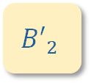
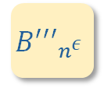

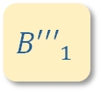
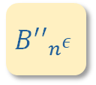
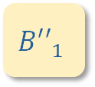
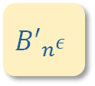
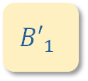
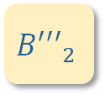
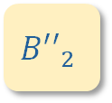
Ideal: this situation happens for all blocks
Ideas:
Combining blocks
  Collect constructed blocks into a single machine
  DP: build a string from these blocks
$$B_{1}$$ | $$B_{2}$$ | … | $$B_{n^{ε}}$$
candidates
$${≥n}^{1−ε}$$
candidates
candidates
$${B′}_{1}$$
$${B′′}_{1}$$
$${B′′′}_{1}$$
$${B′}_{2}$$
$${B′′}_{2}$$
$${B′′′}_{2}$$
$${B′}_{n^{ε}}$$
$${B′′}_{n^{ε}}$$
$${B′′′}_{n^{ε}}$$
…
…
…
Constructed blocks via “cycle removal”
Constructed blocks via “cycle removal”
Constructed blocks via “cycle removal”

Slide 53






Long blocks, short blocks
Ideas:
If $π_{i,j}$ is long
$$π_{i,j}$$
$$D$$
$$≤D$$
$$B_{j}$$
$$d=n^{1−ε}$$
Then $d≪D$
$B_{j}^{′}=n^{1−ε}$dummy symbols
If for a block $B_{j}$, at least two blocks $π_{i,j}$are short $⇒$can not happen too often

Slide 54







Succes attempt = DP + Cycle Removal
Ideas:
Combining blocks
  Collect constructed blocks into a single machine
  DP: build a string from these blocks
$$n^{1−ε}\text{dummy symbols}$$
$$n^{1−ε}\text{dummy symbols}$$
$$n^{1−ε}\text{dummy symbols}$$
candidates
candidates
candidates
$$B_{1}$$ | $$B_{2}$$ | … | $$B_{n^{ε}}$$
candidates
$${≥n}^{1−ε}$$
candidates
candidates
$${B′}_{1}$$
$${B′′}_{1}$$
$${B′′′}_{1}$$
$${B′}_{2}$$
$${B′′}_{2}$$
$${B′′′}_{2}$$
$${B′}_{n^{ε}}$$
$${B′′}_{n^{ε}}$$
$${B′′′}_{n^{ε}}$$
…
…
…
Constructed blocks via “cycle removal”
Constructed blocks via “cycle removal”
Constructed blocks via “cycle removal”

Slide 55



Open questions
$$\text{Offline settings}$$
$$\text{MPC settings}$$
  How far can we push this idea of local – global property?
  Can we do better for Hamming, SF, or Kendall-tau?
  Optimal approx. alg. for Ulam rank aggregation?
  Results for offline Ulam $→$ online Ulam ?
  How about edit distance? For strings?

Slide 56
Toward Fair Representation:
Consensus and Clusterings

Slide 57
Toward Fair Representation:
Consensus and Clustering
Fair Consensus Clustering
$\left(2+α\right)$-approximation
$p=q$, $3$-approximation algorithm
$p:q=p:1$, $19$-approximation algorithm
General, $35$-approximation algorithm
Closest Fair Clustering
$α$-approximation
In $O\left(n\log{n}\right)$ time (n = $|V|$)
$p=q$, optimal algorithm
$p:q=p:1$, $17$-approximation algorithm
General, $33$-approximation algorithm
NP-hard

Slide 58

Toward Fair Representation:
Consensus and Clustering
Fair Consensus Clustering
$\left(2+α\right)$-approximation
$p=q$, $3$-approximation algorithm
$p:q=p:1$, $19$-approximation algorithm
General, $35$-approximation algorithm
Closest Fair Clustering
$α$-approximation
In $O\left(n\log{n}\right)$ time (n = $|V|$)
$p=q$, optimal algorithm
$p:q=p:1$, $17$-approximation algorithm
General, $33$-approximation algorithm
NP-hard

Slide 59






Toward Fair Representation:
Consensus and Clustering
Input
Ground set V
Output
Objective:
$$𝒞= \underset{∀ℱ that is fair}{arg min}{dist(𝒟, ℱ)}$$
$𝒟$ =
$$ℱ=$$
$$dist \left(𝒟, ℱ\right)=| \left\{\left(u,v\right)⊂V\right| u v are not coclustered in 𝒟 and ℱ\} |$$
$$Red\left(V\right):Blue\left(V\right)=p:q$$
Every cluster in the OUTPUT must maintain $p:q$

Slide 60











Optimal algorithm when $p=q$
Fix: optimal solution $ℱ$
$C$ points from other clusters of the input
WLOG: $b≤r$, then $C≥r−b$
$ℱ$ =
split
$r$ points
$$r−b$$
$b$ points
$$b$$
$$b$$
From the same cluster of the input
Cost decreases by at least:
$$2b×C −2b×\left(r−b\right)=2b\left(C−\left(r−b\right)\right)≥0$$
We can be GREEDY

Slide 61








Optimal algorithm when $p=q$
Step 1
For each cluster $C∈𝒟$
Step 2:
Iteratively merge-cut clusters in $S$
Singleton $S$
If $C=$
If $C=$
$$|Blue\left(S\right)|=|Red\left(S\right)|$$
$$Blue(S)$$
$$Red(S)$$

Slide 62








Optimal algorithm when $p=q$
Step 1
For each cluster $C∈𝒟$
Step 2:
Iteratively merge-cut clusters in $S$
Singleton $S$
If $C=$
If $C=$
$$|Blue\left(S\right)|=|Red\left(S\right)|$$
$$Blue(S)$$
$$Red(S)$$

Slide 63






This approaches does not work for arbitrary $p:q$
Fix: optimal solution $ℱ$
$C$ points from other clusters of the input
$ℱ$ =
split
$r$ points
$b$ points
$$kp$$
$$kq$$
From the same cluster of the input
Divisibility is the problem

Slide 64



Approx. Algorithm for $p:q$
Step 1:
Transform input clustering $𝒟$ into $𝒟′$ such that $∀C∈𝒟^{′}$:
$p | |Blue\left(C\right)|$
$q | |Red\left(C\right)|$
Step 2:
Make $𝒟′$ fair

Slide 65


Open questions
$$\text{Offline settings}$$
$$\text{Scalable settings}$$
  Improve approx. closest fair, APX-hard ?
  Online with recourses
  Optimal algorithm for consensus clustering ?
  Dynamic with update time
  Other fairness notions ?
  MPC

Slide 66

AI Disclosure
These works belong to the ancient times, BC era
BC = Before ChatGPT 5.5

Slide 67
THANK YOU!

